Slide 1

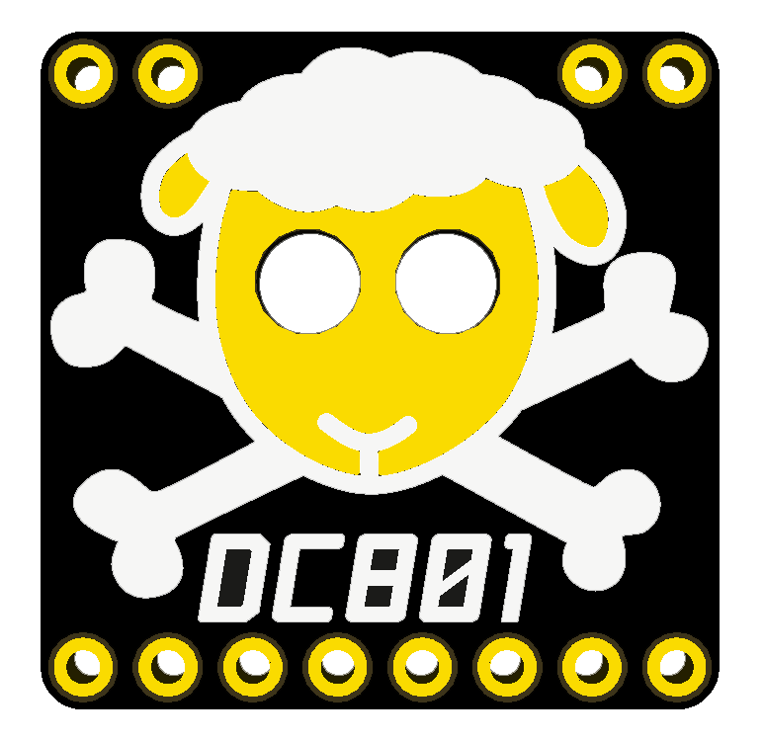
Getting Started with KiCad
Designing the less shitty Shitty Add On

Slide 2
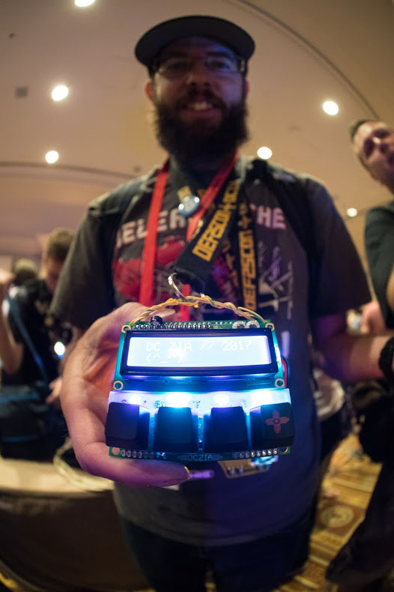
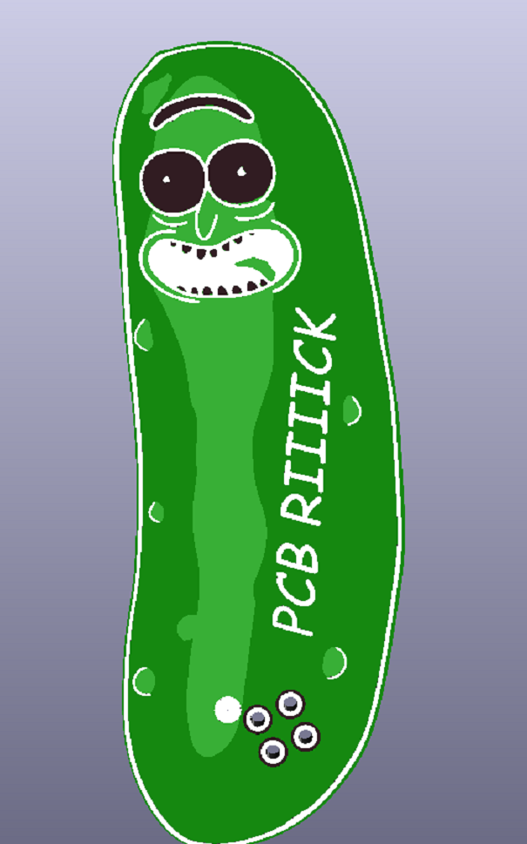
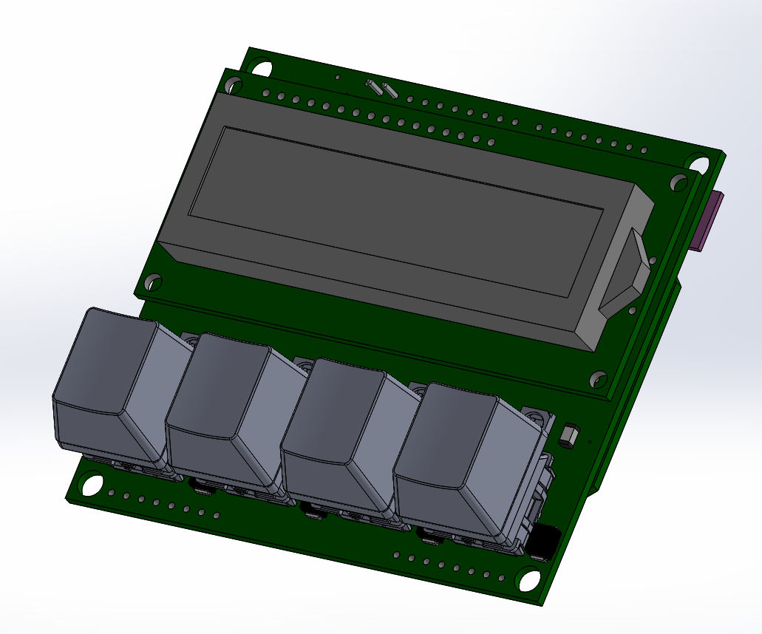
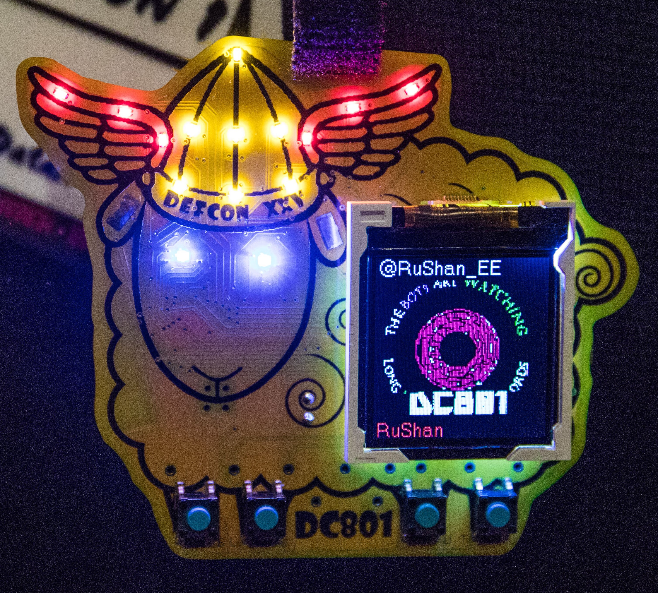
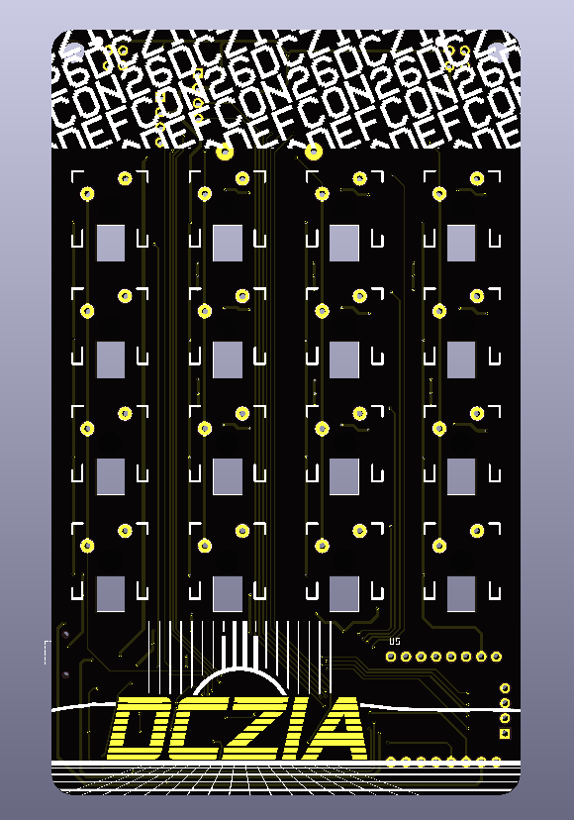
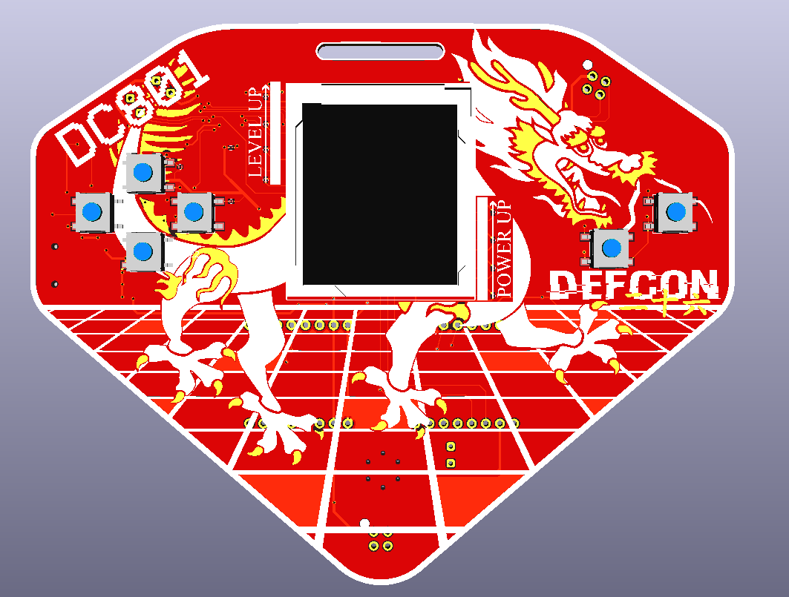
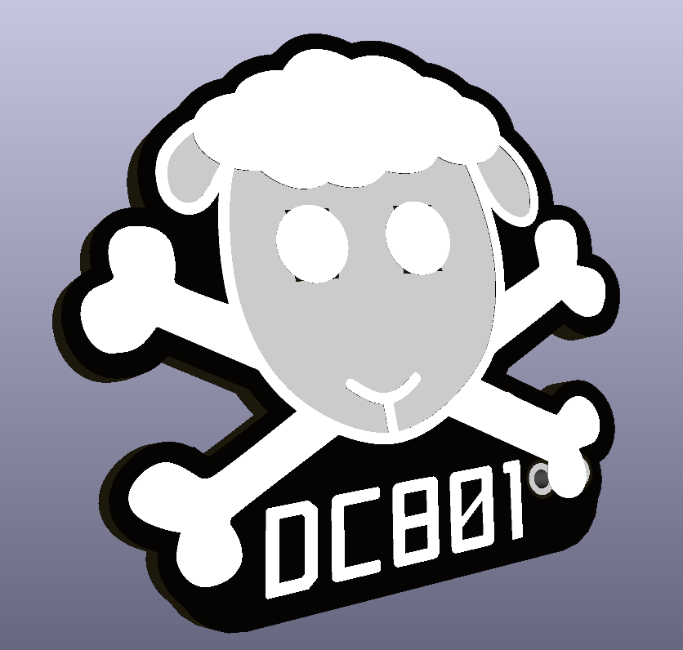
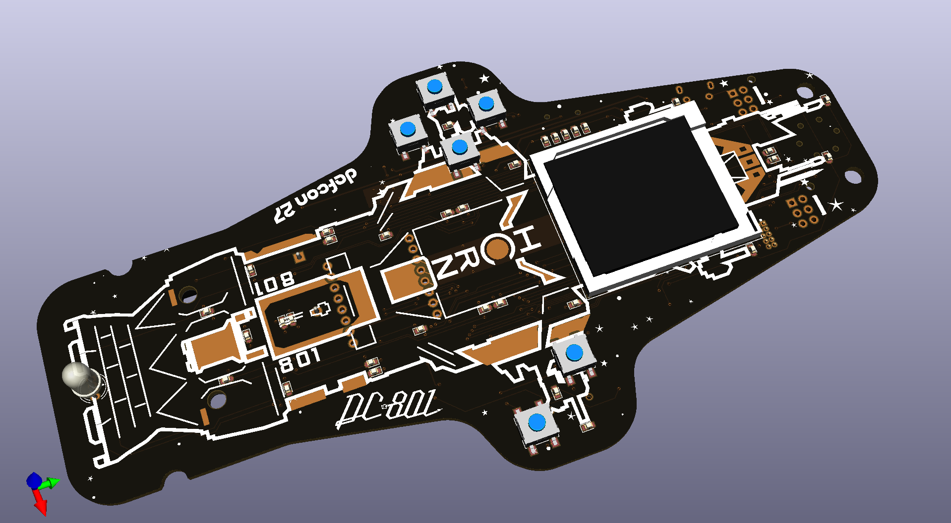
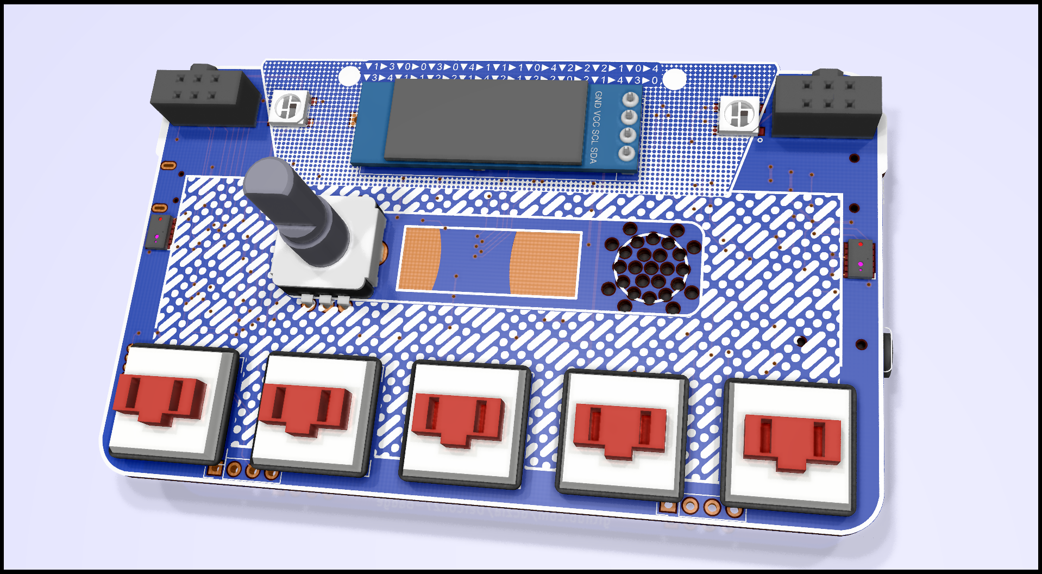

Intro
Who am I and how did I get in here?
KiCad: Getting Started

Slide 3
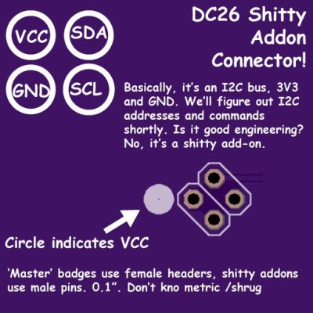
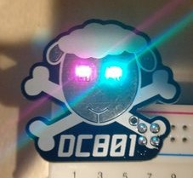

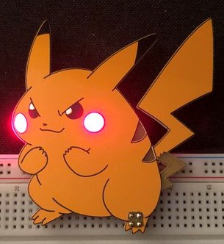
SAOs
SAO – Shitty Add On
Designed by Brian Benchoff on a whim for DC26
Small boards that plug into a badge for power
KiCad: Getting Started

Slide 4
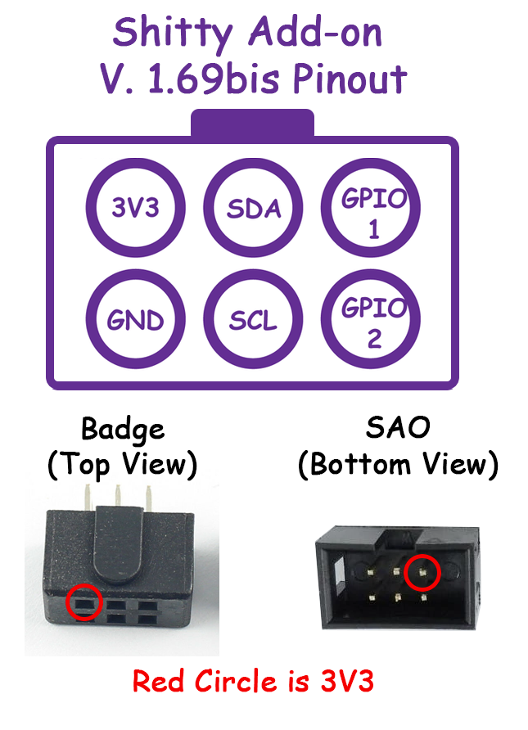
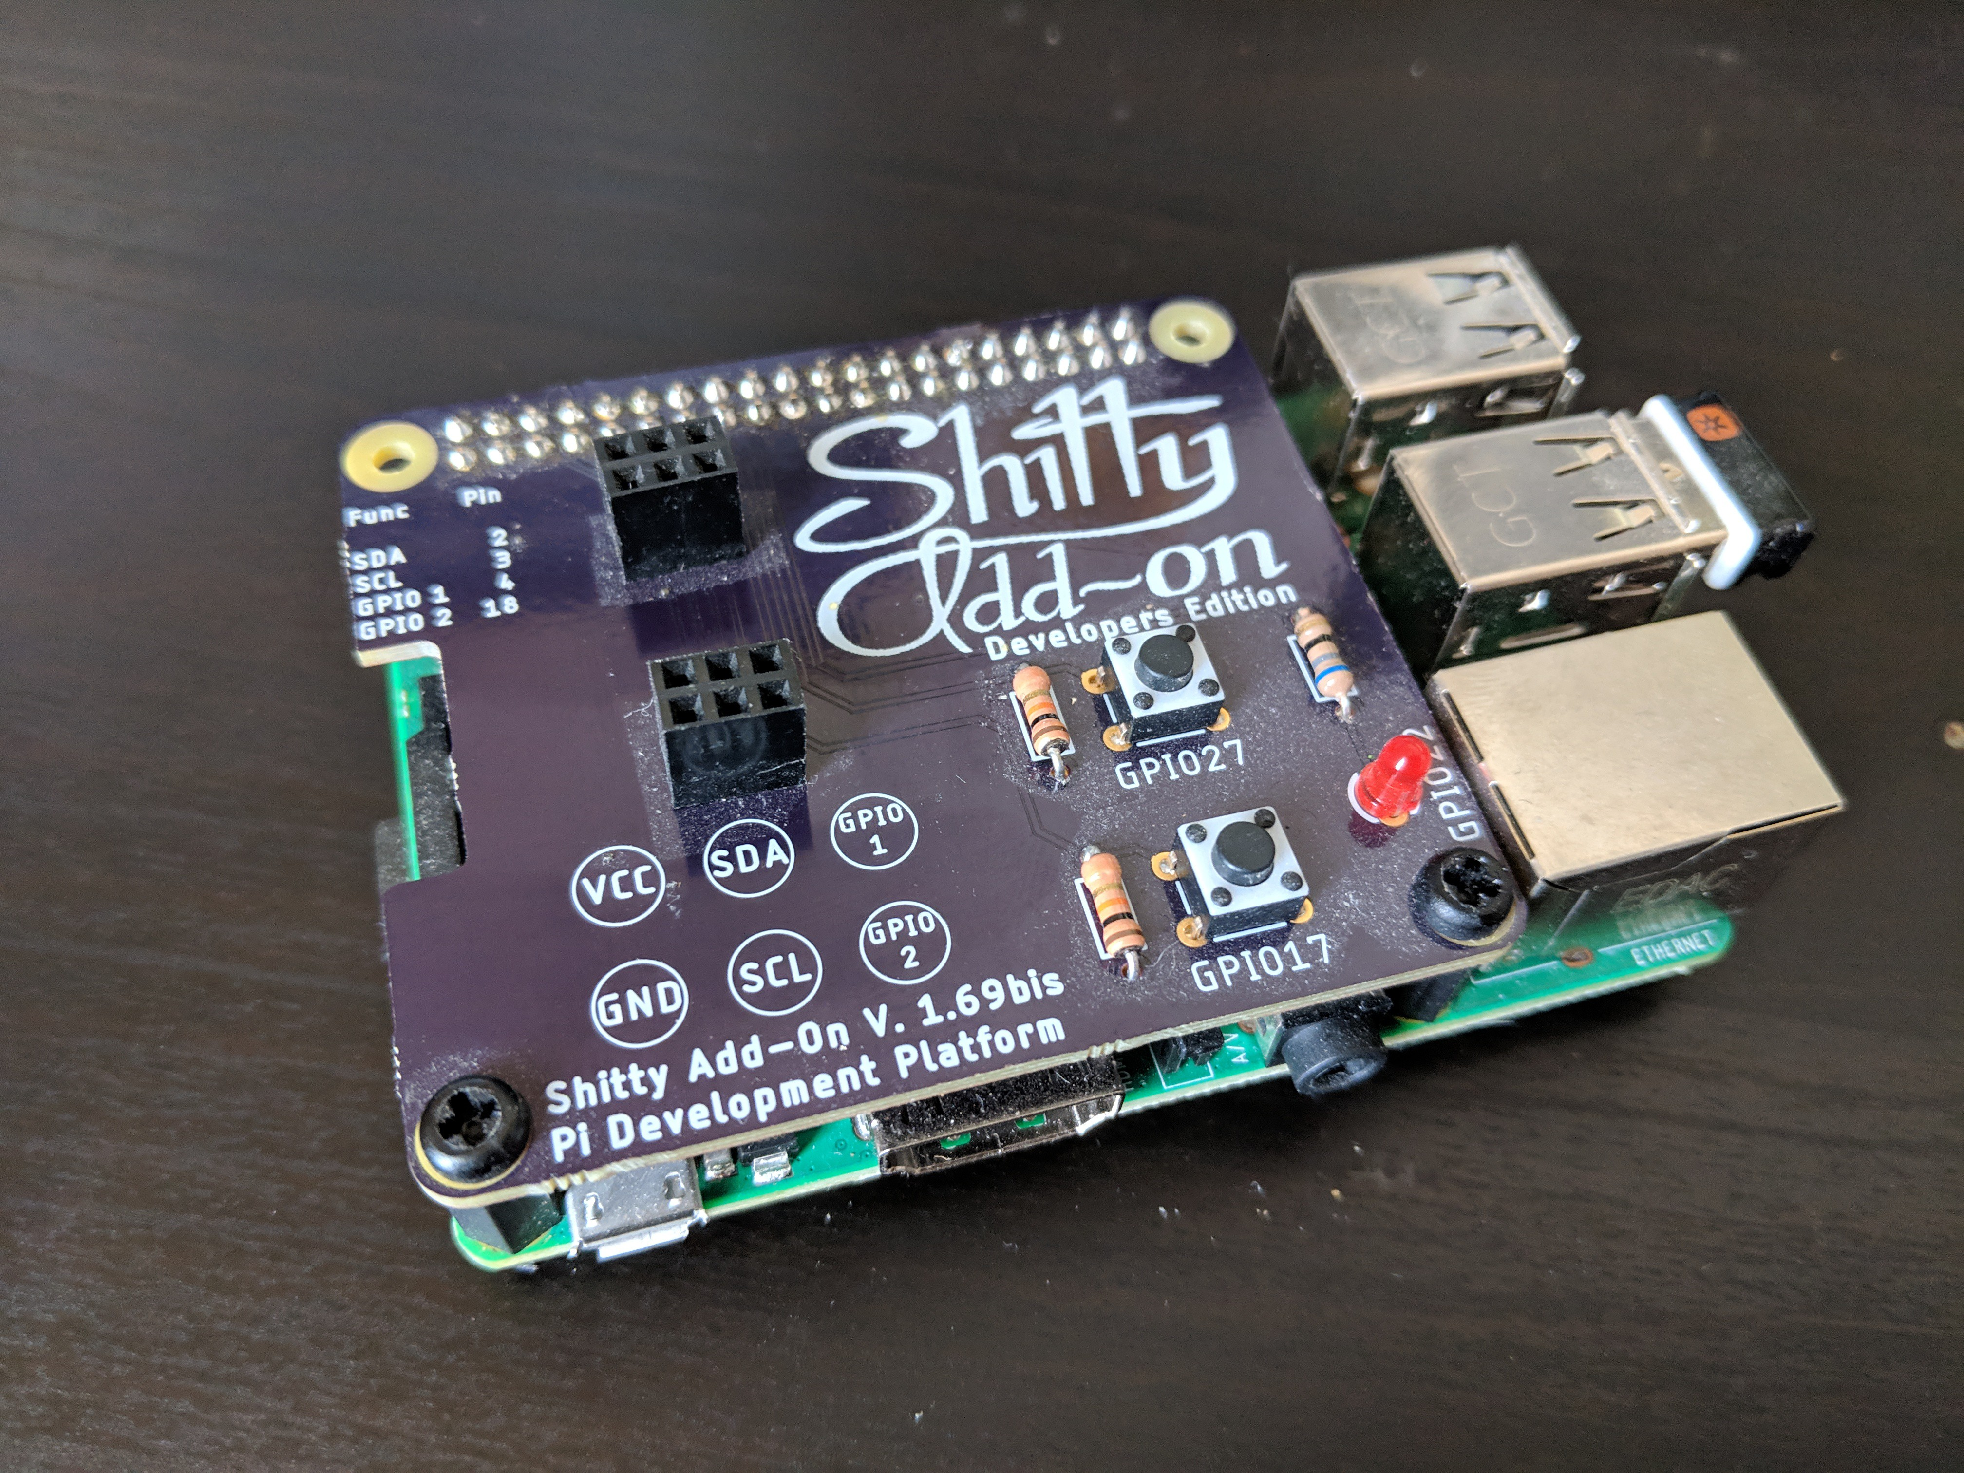
SAOs
New for Defcon 27 – SAO v1.69bis
Backwards compatible, still as shitty
Now with more pins, better retention
KiCad: Getting Started

Slide 5
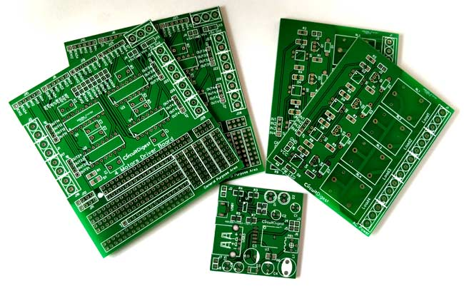
Printed Circuit Boards
Printed Circuit Board – PCB
Consists of layers of insulation, copper, and printed graphics
Board houses like to specify board dimensions in millimeters, but trace widths in mils (0.001 inches)
KiCad: Getting Started

Slide 6
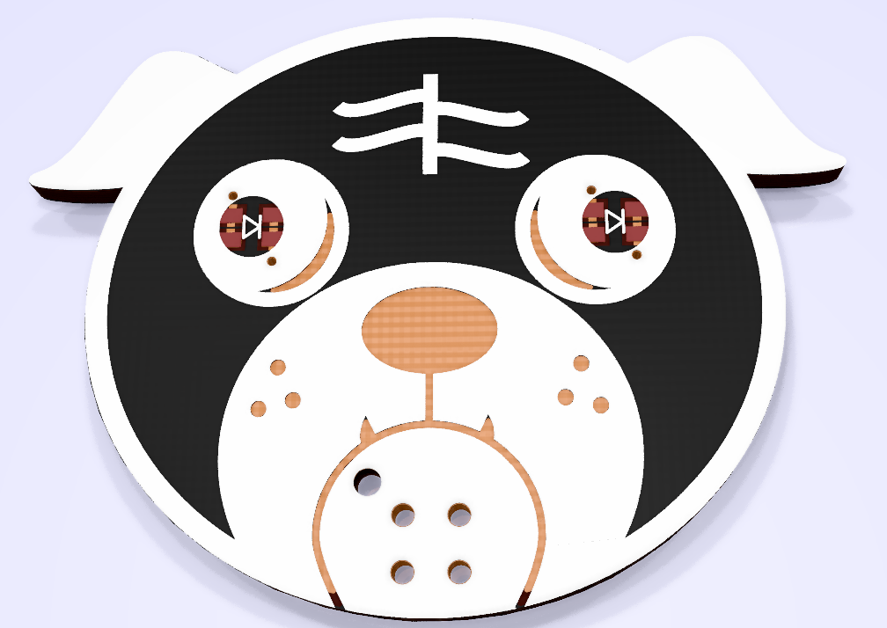
Printed Circuit Boards
Vias – holes, may be plated
Traces – thin copper lines, ‘wires’
Pours – Large areas of copper
Silkscreen – Artwork or labels
Copper
Pour
Via
Silkscreen
KiCad: Getting Started

Slide 7
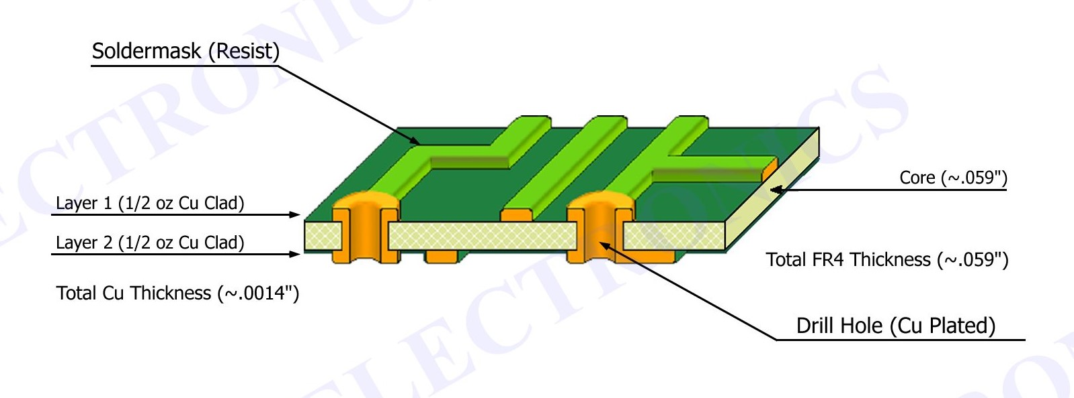
Printed Circuit Boards
Typical 2 layer stackup
KiCad: Getting Started

Slide 8
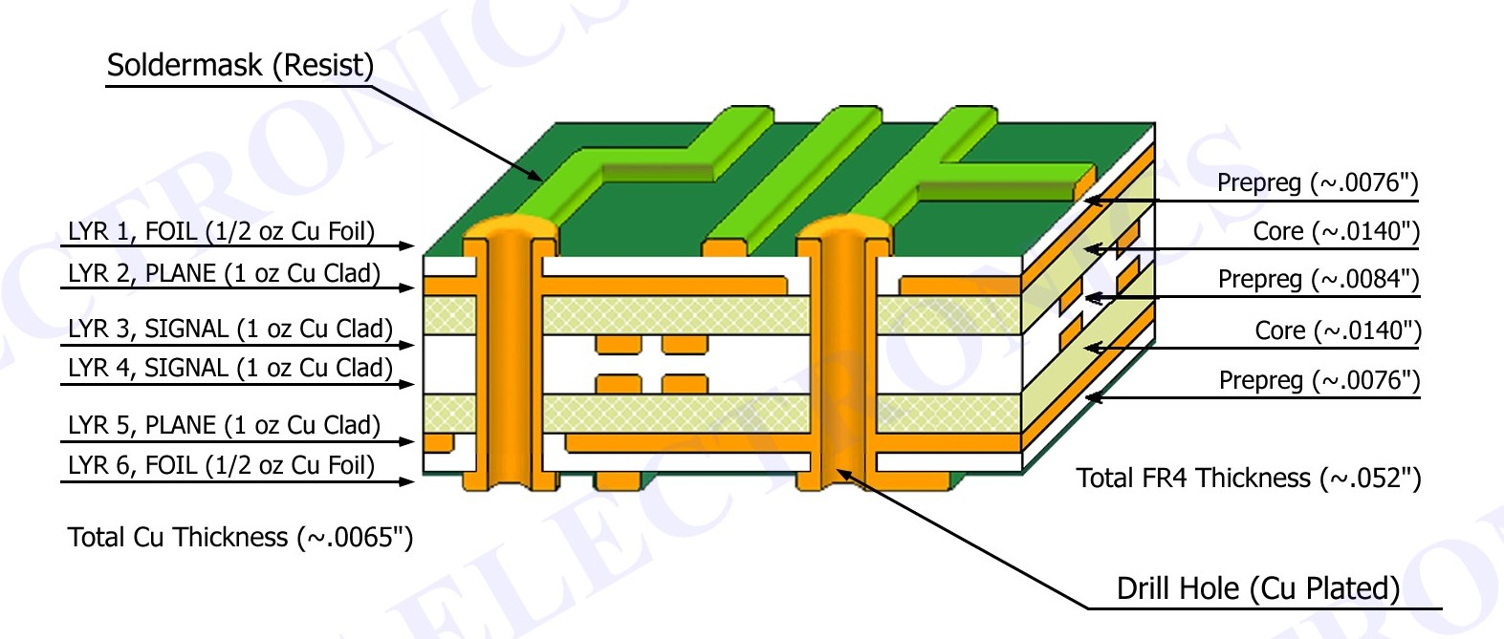
Printed Circuit Boards
Keep adding layers!
KiCad: Getting Started

Slide 9

Printed Circuit Boards
Copper Finish - OSP vs HASL vs ENIG
Organic Solderability Preservative Usually a gold color – handling will stain it
Hot Air Solder Leveling Silver finish – it’s solder dipped
Electroless Nickel Immersion Gold Gold color – handles well
HASL usually default – other options are more $$
KiCad: Getting Started

Slide 10

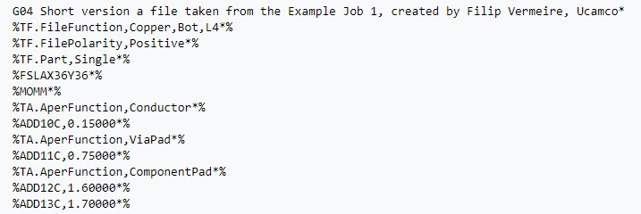
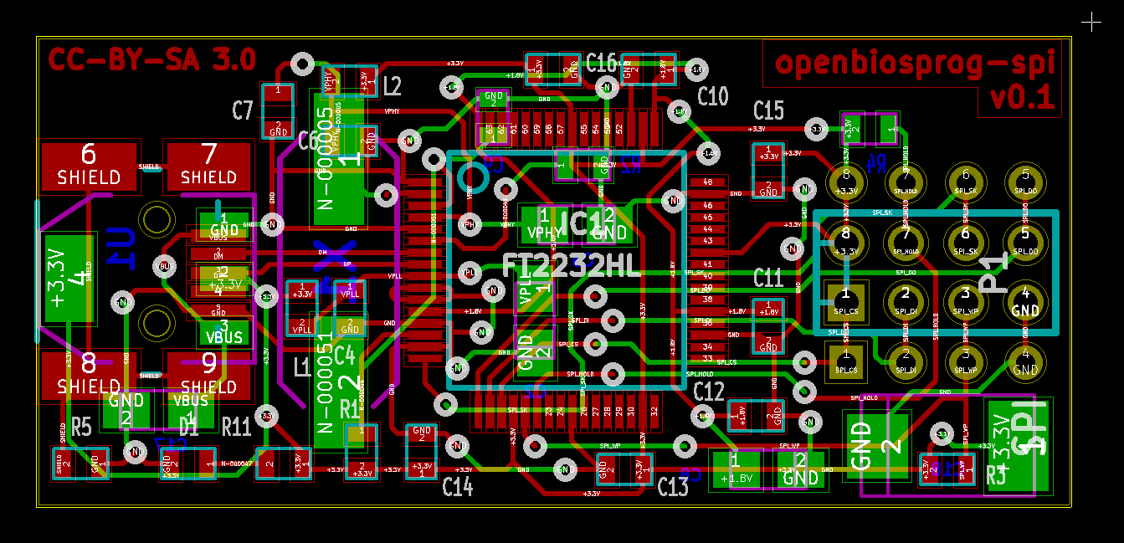
Printed Circuit Boards
Gerbers ASCII format for describing board layout Released in 1980!
KiCad: Getting Started

Slide 11

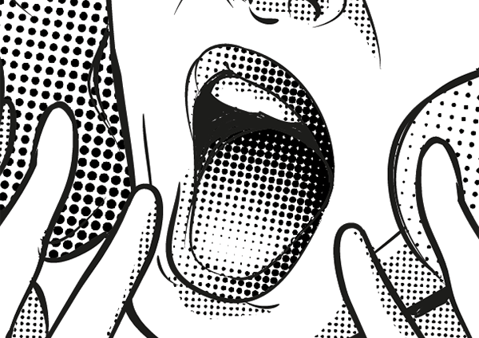

Artwork for PCBs
Bad
Design with PCB limitations in mind
Silkscreen, Soldermask, Copper and bare PCB are your color palette
Tiny details will get lost
No gradients – try using halftones
Good
OMG Halftones!
KiCad: Getting Started

Slide 12
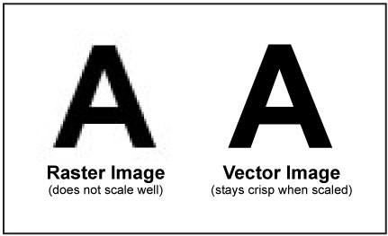
Artwork for PCBs
Vector vs Bitmap Try to design with vector
Suggested Software Inkscape, Illustrator
KiCad: Getting Started

Slide 13
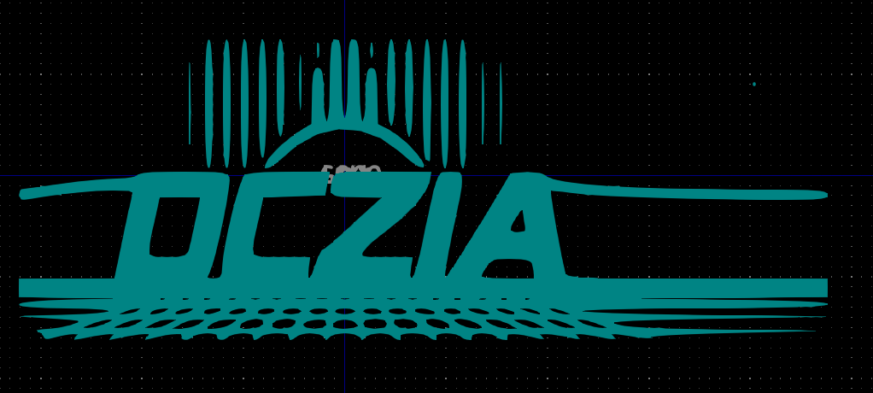
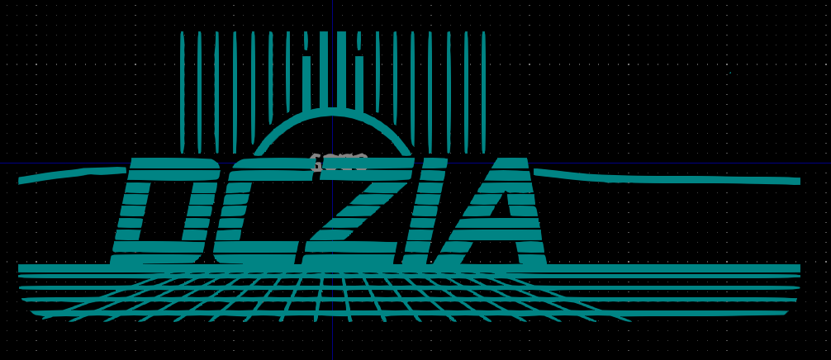
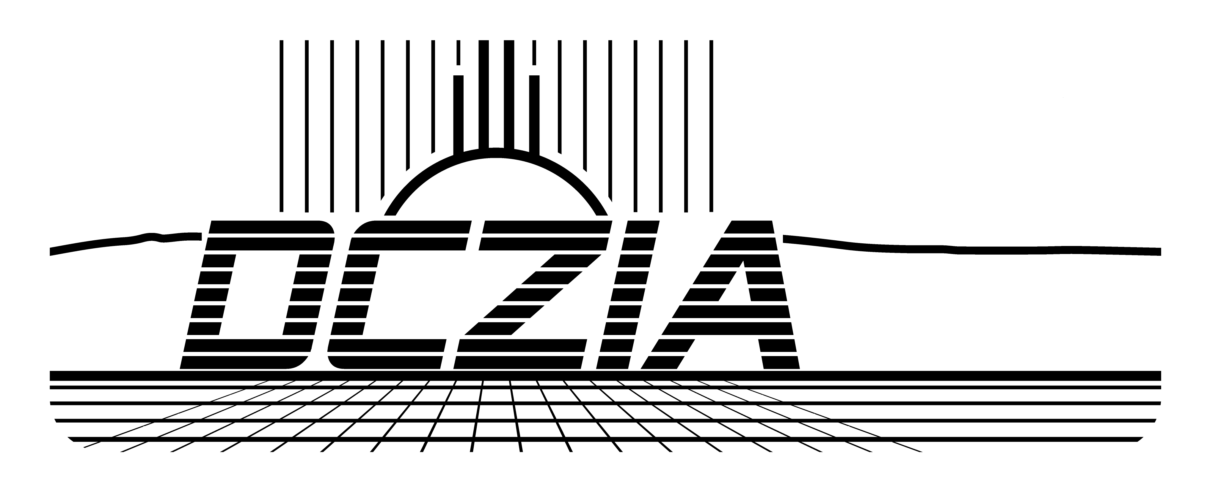
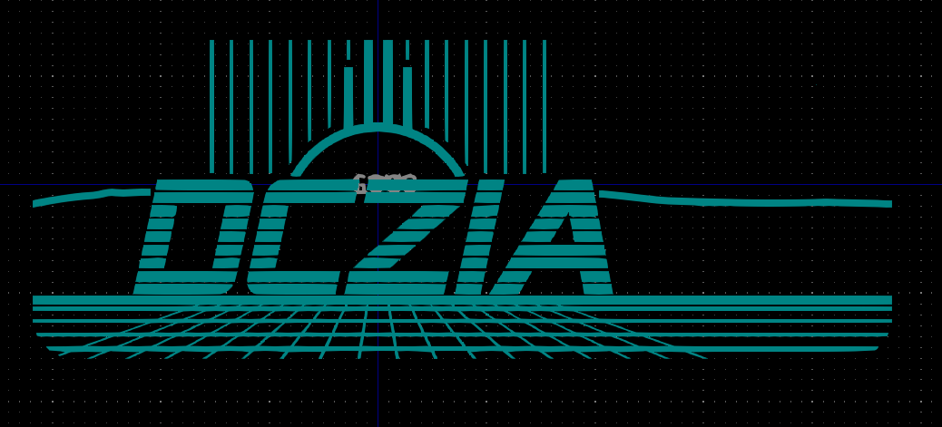
Artwork for PCBs
72DPI
Scaling and exporting Design your art at 1:1 scale to the real deal Export your image at high DPI – I use 1200DPI
300DPI
Source
1200DPI
KiCad: Getting Started

Slide 14



Artwork for PCBs
Simplfy Layers Export each layer as a different image Black and white only
Bare Copper Layer
Design File
Silkscreen Layer
KiCad: Getting Started

Slide 15
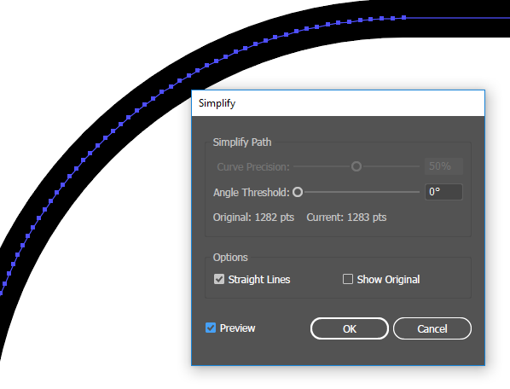
Artwork for PCBs
Edge cuts and outlines Designing at 1:1 means you can export your outline as a DXF KiCad DXF import cannot import curved lines! Add anchor points, then simplfy paths to straight lines to approximate a curve
KiCad: Getting Started

Slide 16

Artwork for PCBs
Hands on!
KiCad: Getting Started

Slide 17

KiCad
What is KiCad?
Started in 1992
Open source, lots of development
KiCad’s first con was held in Chicago last month
KiCad covers both Schematic Capture and Board Layout
KiCad: Getting Started

Slide 18
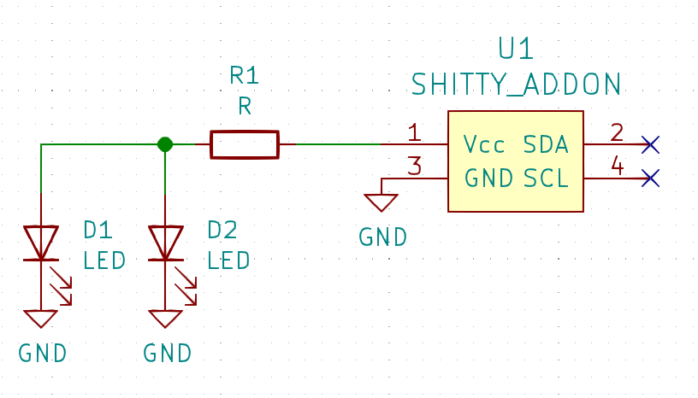
KiCad - Schematic
Schematic capture
Start here to design your circuit
Keep it neat for readability
KiCad: Getting Started

Slide 19
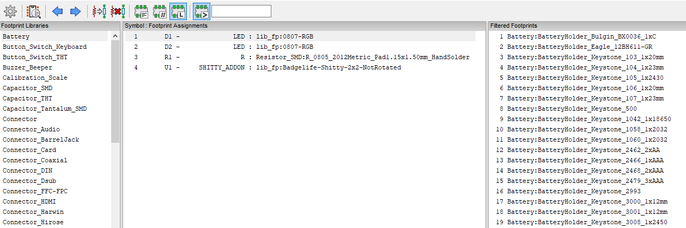
KiCad - Schematic
Schematic footprint association For each part, assign a footprint
Save, then generate a netlist
KiCad: Getting Started

Slide 20

KiCad - Schematic
Hands on!
KiCad: Getting Started

Slide 21
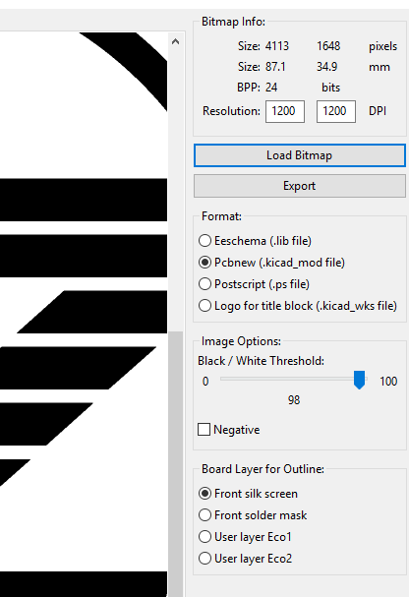
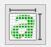
KiCad - Import
Importing artwork with Bitmap to Component Convertor
If you designed to scale, this is an easy step
The convertor converts a bitmap to a vector that KiCad can use
We can move the layers around later
KiCad: Getting Started

Slide 22
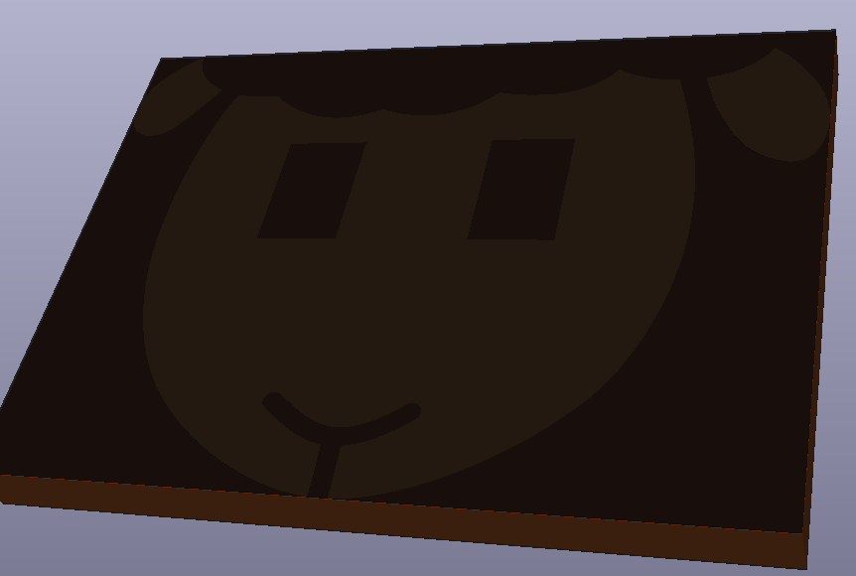
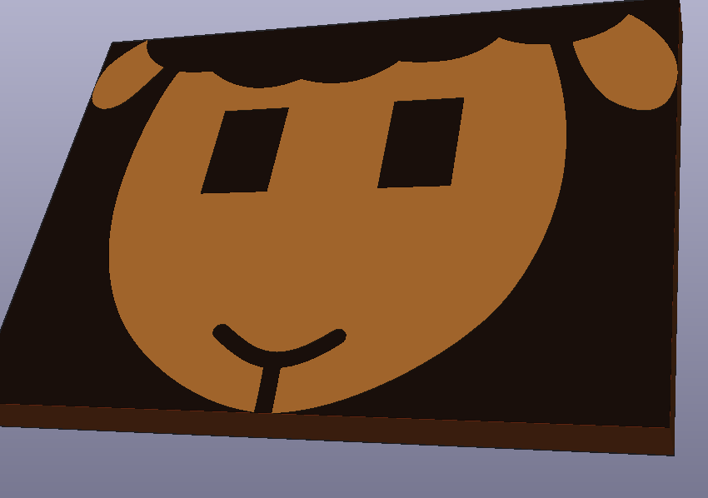
KiCad - Import
After conversion, you can use the footprint editor to move layers around
Bare copper is copper without a soldermask. In KiCad, this means adding a shape to the soldermask layer Soldermask layer is a negative layer! Just copy and paste in place the copper polygon you want to expose and move to soldermask
Without soldermask Hole
With soldermask Hole
KiCad: Getting Started

Slide 23

KiCad - Import
Hands on!
KiCad: Getting Started

Slide 24
KiCad - PCB
Create a new board layout and open your netlist
Place your imported footprints
Import your outline
Place your component footprints
KiCad: Getting Started

Slide 25
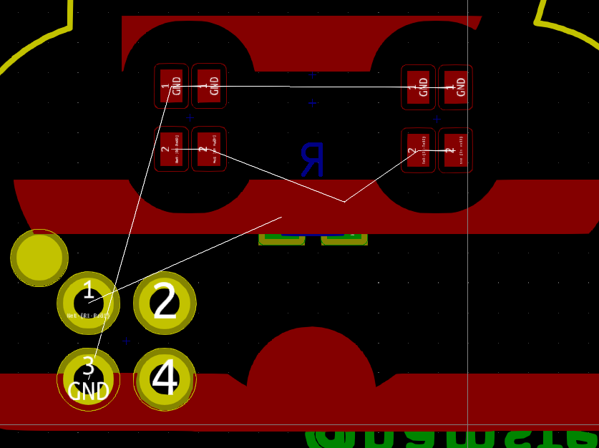
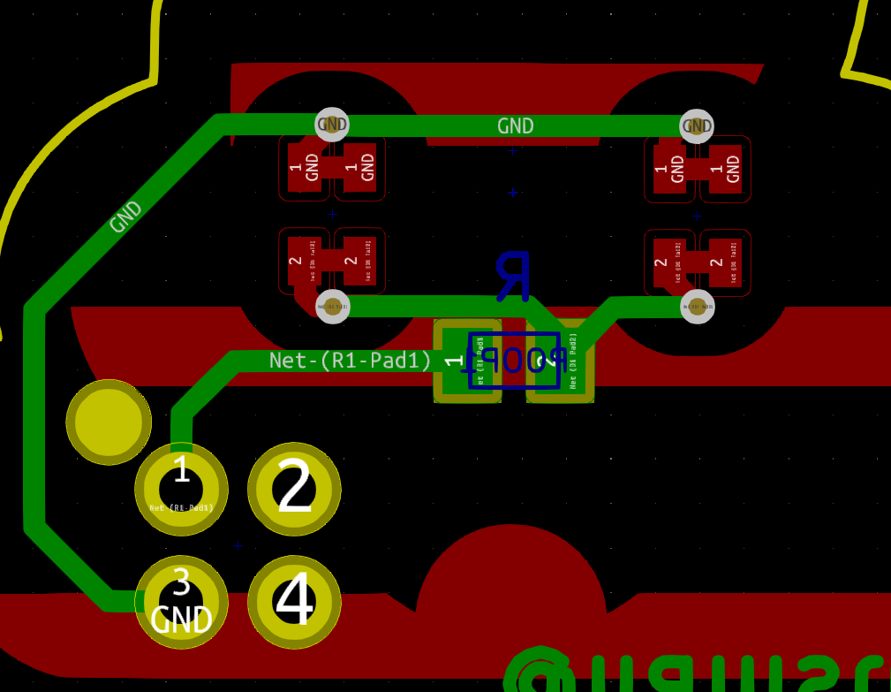
KiCad - PCB
Solve the rats by laying down traces
Note that most board houses have a limit of 6mils trace/space unless you want to pay more
KiCad: Getting Started

Slide 26

KiCad - PCB
RUN DRC
Seriously
Do it
Design Rules Check
KiCad: Getting Started

Slide 27

KiCad - PCB
Hands on!
KiCad: Getting Started

Slide 28
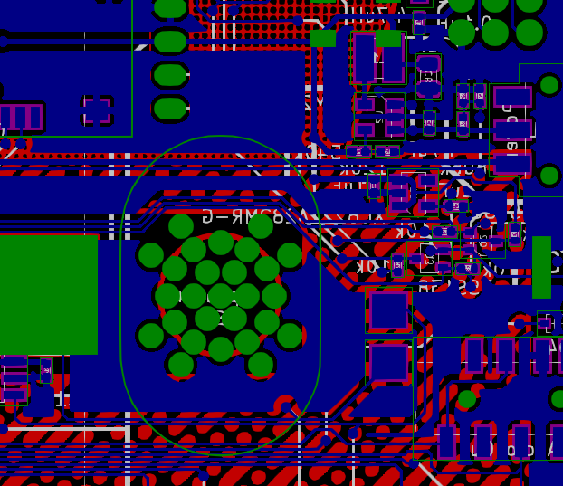
Bringing it all together
Export Gerbers
At the very least, you need top and bottom copper, silk, and soldermask
Check with your board house for specific requirements
Check the result in gerbv or other Gerber viewer before sending out
KiCad: Getting Started

Slide 29

Bringing it all together
Hands on!
KiCad: Getting Started

Slide 30
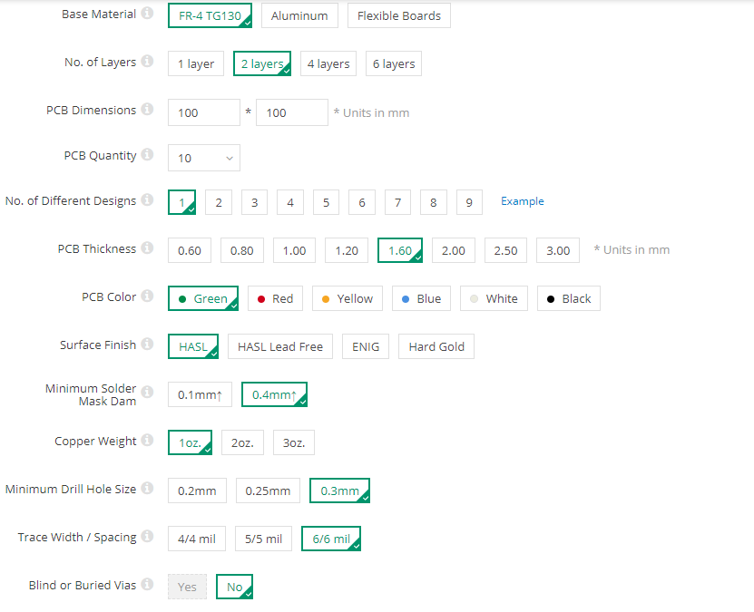
Ordering boards
Typical options
Less than 100x100mm is cheap
Play with the options
Sometimes an extra 100 boards is just a few bucks more
KiCad: Getting Started

Slide 31
Ordering boards
China board houses are cheap, but you have to wait for shipping Quality is pretty darn good Delay one day! – due to time difference, simple questions can cause delays
OSH Park is a good option in the States for a reasonable price But I hope you like purple…
Fab Assembly can get pricey – consider doing it by hand for simple designs
KiCad: Getting Started

Slide 32
Sourcing Parts
Aliexpress is a good option if you have time and are willing to risk it
Choose Amazon if you want the same aliexpress stuff with a markup and Prime shipping
Digikey, Mouser are tried and true
Arrow is a strange option, they usually have free overnight shipping and most parts
If the fab is going to assemble it, let them source parts where possible
KiCad: Getting Started

Slide 33
Questions?
Snide Comments?
@hamster
KiCad: Getting Started

